Slide 2
5D The typical set

Slide 3
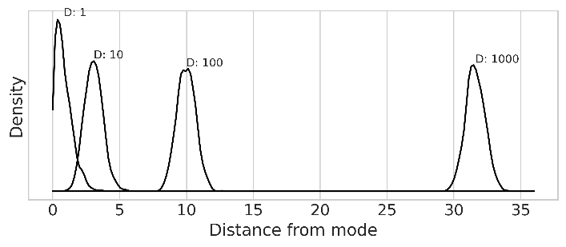
In high dimensions, things are weird
Most of the probability is far from the mode
def rad_dist(Y):
return np.sqrt(np.sum(Y**2))
for D in [1, 10, 100, 1000]:
T = int(1e3)
Y = stats.multivariate_normal(np.zeros(D), np.identity(D)).rvs(T)
Rd = list(map(rad_dist, Y))

Slide 4
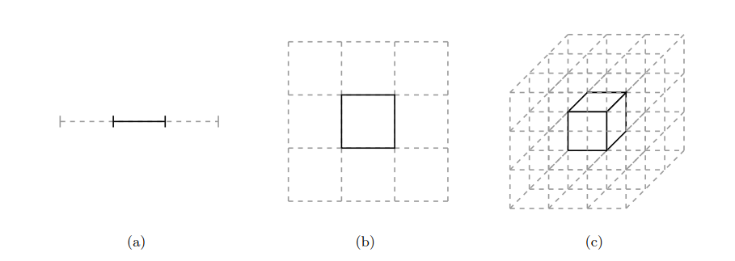
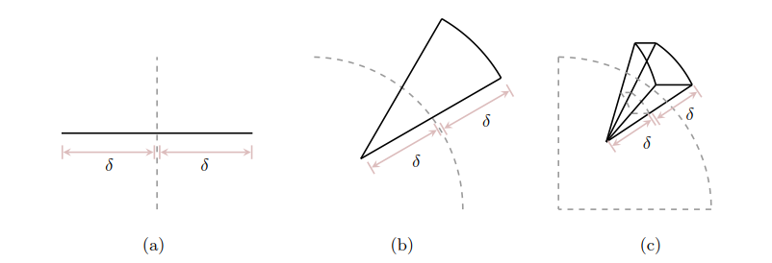
Because most of the space is far from the mode
Consider a N-D cube
What percentage is in the middle?
Consider a spherical shell
Let dimensionality increase
Look at exterior and interior volume

Slide 5
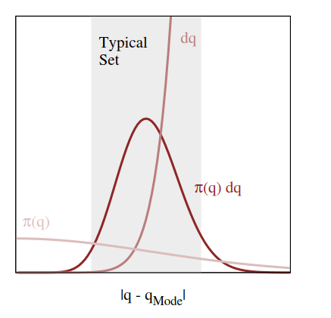

This means expectations are dominated by a “typical set”
Visualization of a typical set in high dimensions

Slide 6

Efficient sampling
Focus on the typical set
No reason to sample where $p\left(θ∣y\right)=0$

Slide 7
5E Quadratic approximations

Slide 8
Sample from something easier
We want to sample from the posterior
Instead, we can sample from an approximation

